Slide 1
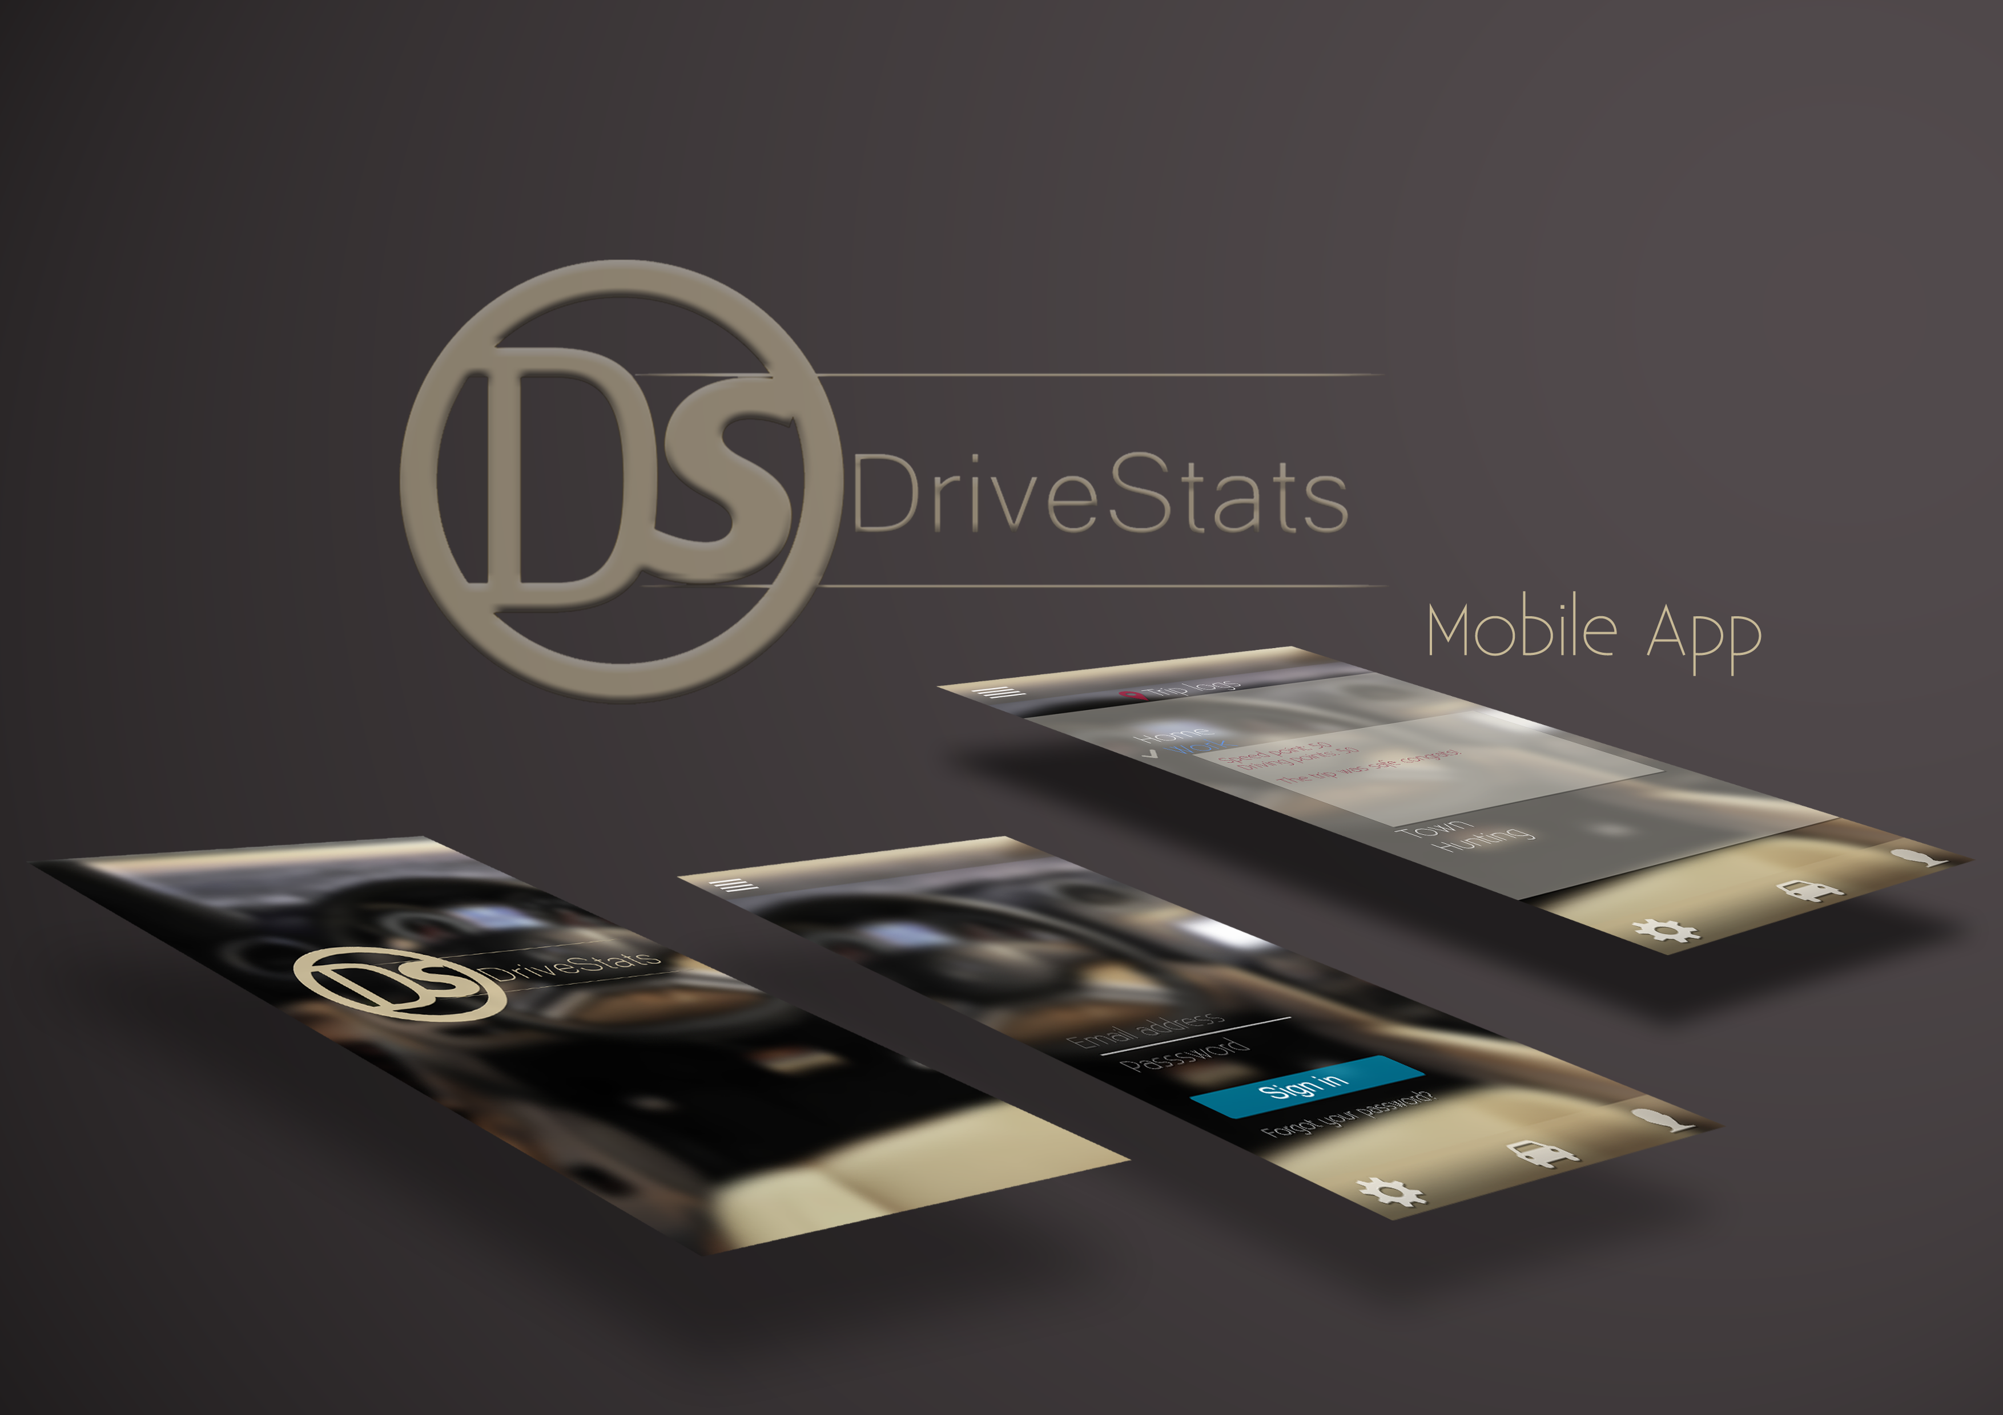

Slide 2
Meet The Team
Axel Ind: Documentation, Presentations
Zander Boshoff: .NET Programming
Nick Robinson: Mobile Programming
Tim Kirker: Unit Testing, HTML, Field Testing, Compliance checking, Research
William Seloma: GUI, Unit Testing, Field Testing, Version Control, Unit programming, Research

Slide 3
What We’re Doing
Enthusiastically creating and implementing an application using a .NET server and Android Client.
The aim of this project is to produce an app that can record and monitor the driving activity of South African residents and improve driver safety across a range of indicators.
Our project was created to service the Client DVT

Slide 4
Our Initial Concepts For UI

Slide 5
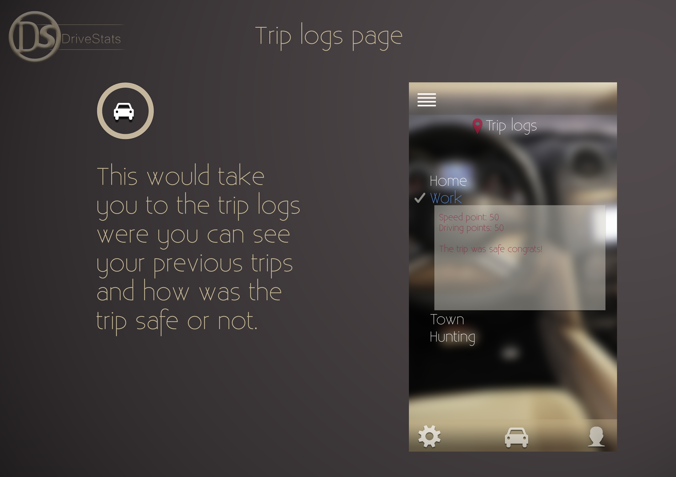

Slide 6
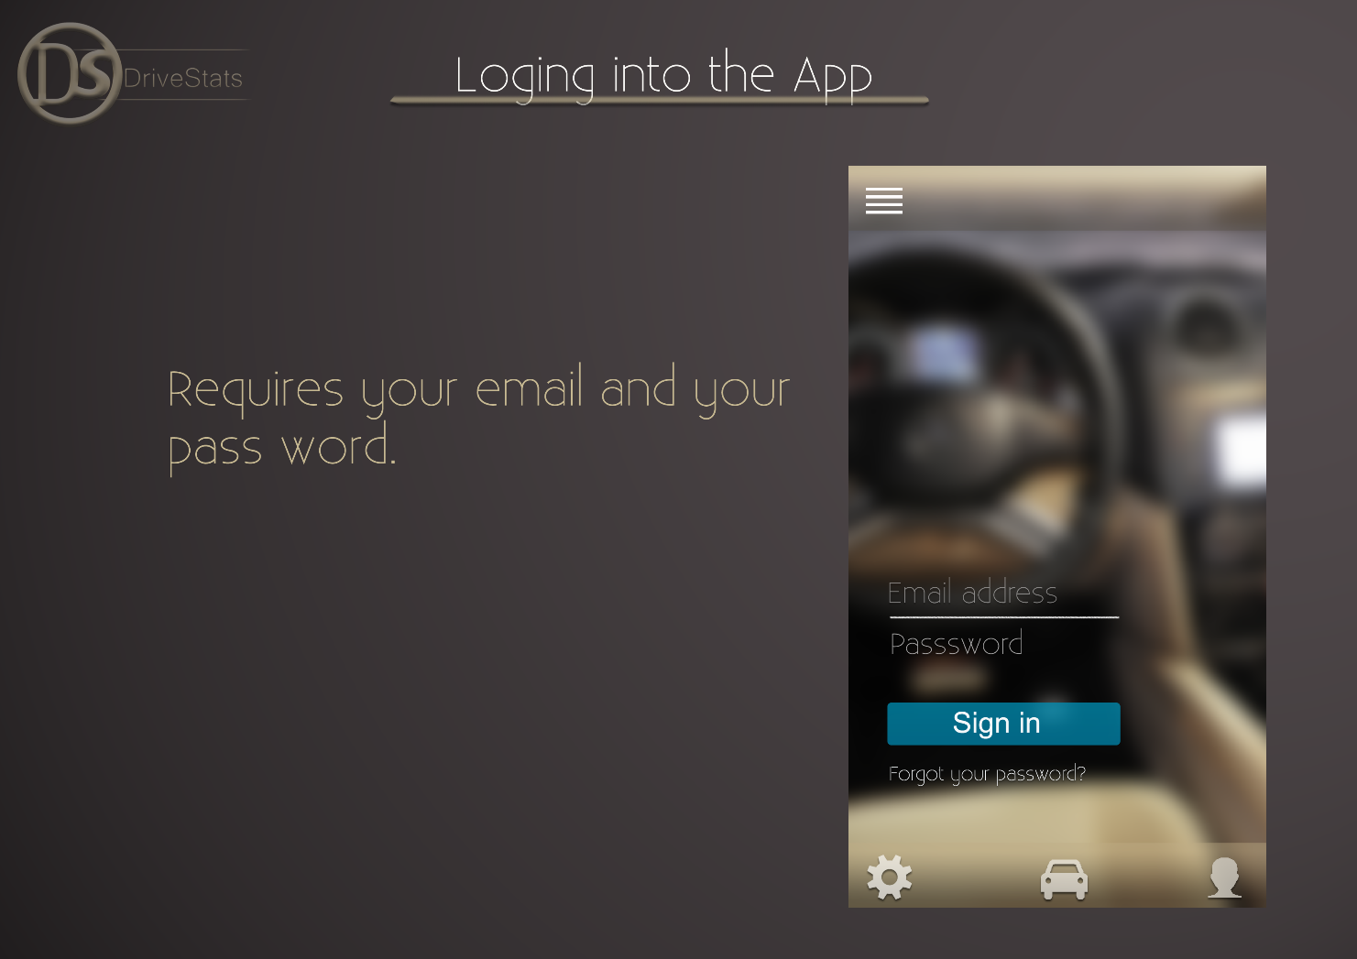

Slide 7
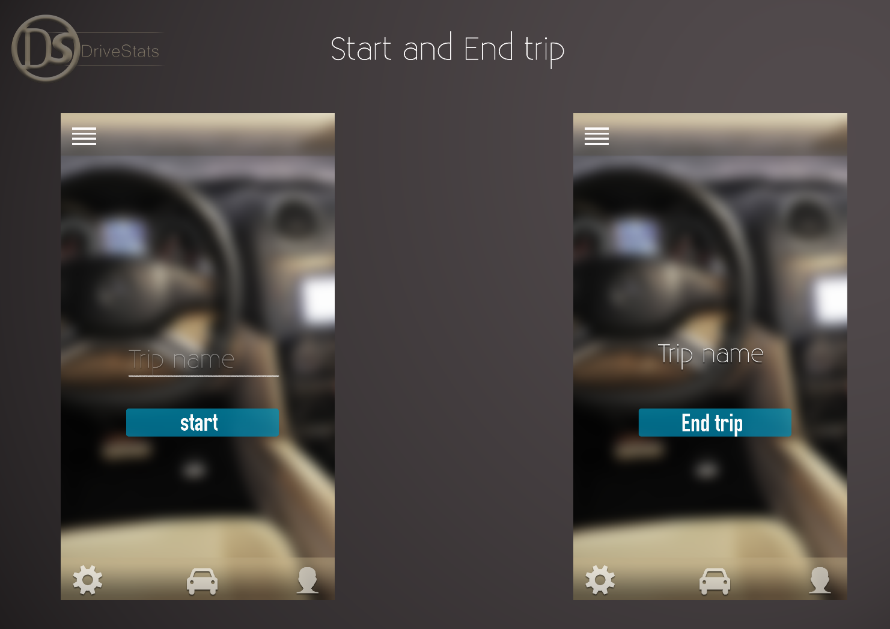

Slide 8
And many more ideas to come…

